Slide 1
To develop your AI application MATLAB is all you need
By Giulio Mattera and Vincenzo Scognamiglio
giulio.mattera@unina.it
vincenzo.scognamiglio2@unina.it

Slide 2


MATLAB Ambassadors Introduction
Vincenzo Scognamiglio
PhD student at ITEE
Research topic: Autonomous navigation in GPS denied environment
Contact: vincenzo.scognamiglio2@unina.it
Giulio Mattera
PhD student at DICMAPI
Research topic: Intelligent Robotics for Additive Manufacturing
Contact: giulio.mattera@unina.it

Slide 3
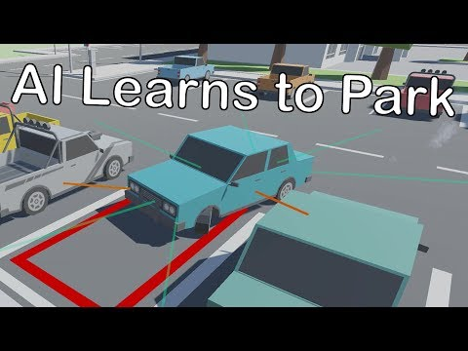
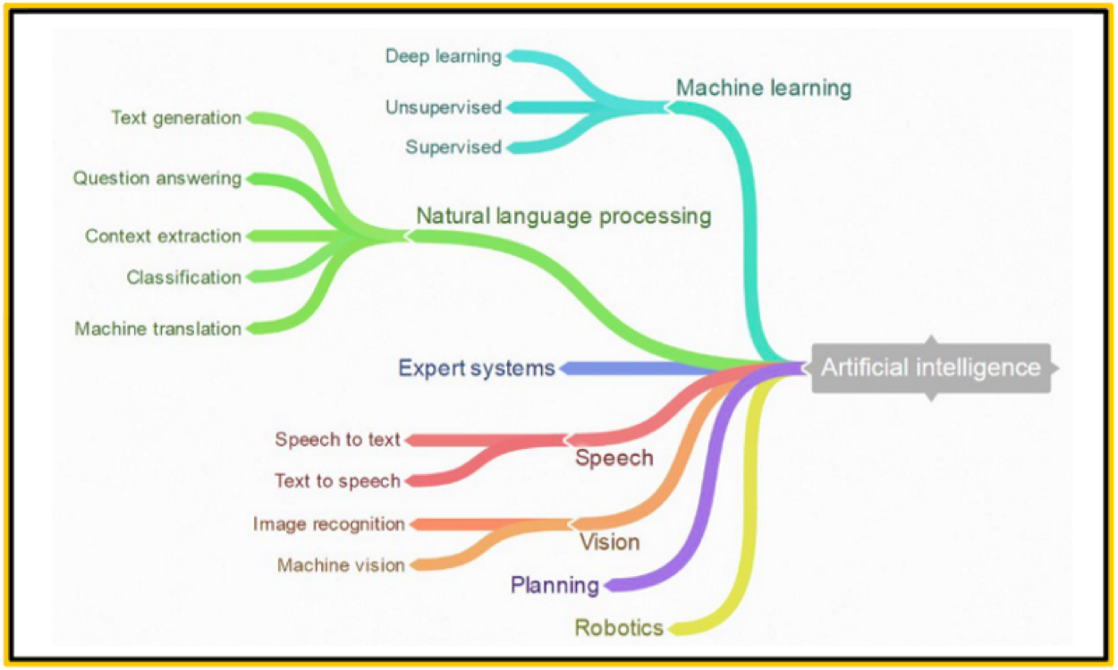
Artificial intelligence
Computer systems able to perform tasks normally requiring human intelligence, such as visual perception, speech recognition, decision-making

Slide 4
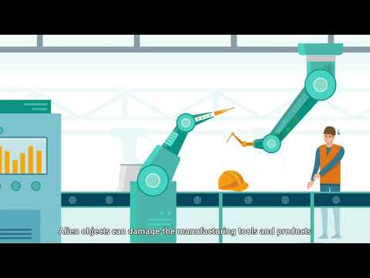
Artificial intelligence
Computer systems able to perform tasks normally requiring human intelligence, such as visual perception, speech recognition, decision-making

Slide 5
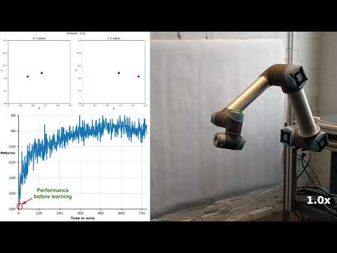
Artificial intelligence
Computer systems able to perform tasks normally requiring human intelligence, such as visual perception, speech recognition, decision-making

Slide 6
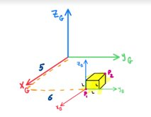
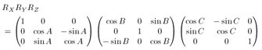
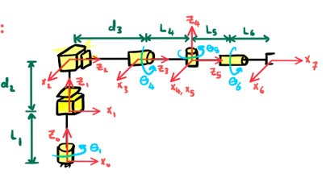
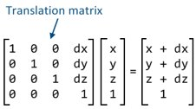
Artificial intelligence : robotics
Robot are set of links (ideally rigid) connected together with joints to perform a specific task (welding, assembly,...)​
Since it is possibile describe a point defined in a reference frame to another one using rotation and translational matrix, a kineamtics chain that describe robot movements can be found​

Slide 7
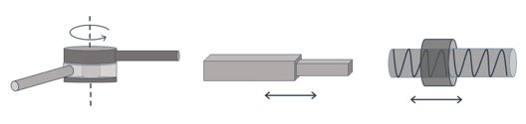
Artificial intelligence : robotics
Robot are set of links (ideally rigid) connected together with joints to perform a specific task (welding, assembly,...)​
Since it is possibile describe a point defined in a reference frame to another one using rotation and translational matrix, a kineamtics chain that describe robot movements can be found​
The principally joints used in the robotic kinematics chain are:​
​
Prismatic​
Revolute​
Fixed

Slide 8
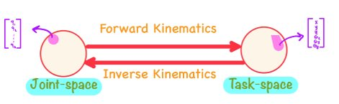
Artificial intelligence : robotics
Robot are set of links (ideally rigid) connected together with joints to perform a specific task (welding, assembly,...)​
Since it is possibile describe a point defined in a reference frame to another one using rotation and translational matrix, a kineamtics chain that describe robot movements can be found​
Forward kinematics allow to found the TCP (Tool Center Point) position respect to a world frame, once all joints coordinates are choosen. ​

Slide 9
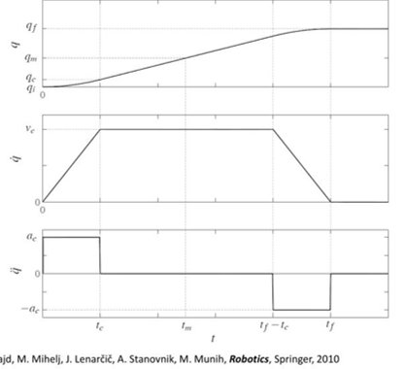
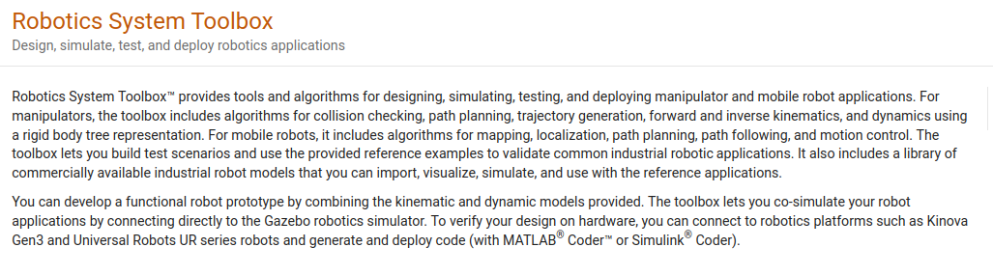
Artificial intelligence : robotics
Usually the inverse kinematic problem is more interesting, since allow to define a task in the world space and transform the world-coordinates into robot coordinates.
Once waypoints are defined a motion law have to be set. Usually a S-shape law (or trapezoidal) is chosen to interpolate all joints points.
https://it.mathworks.com/help/robotics/index.html?s_tid=CRUX_lftnav

Slide 10
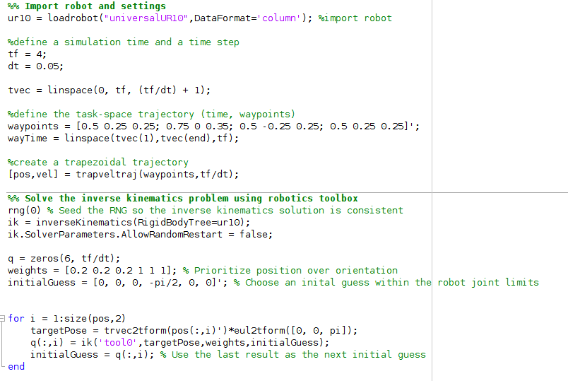
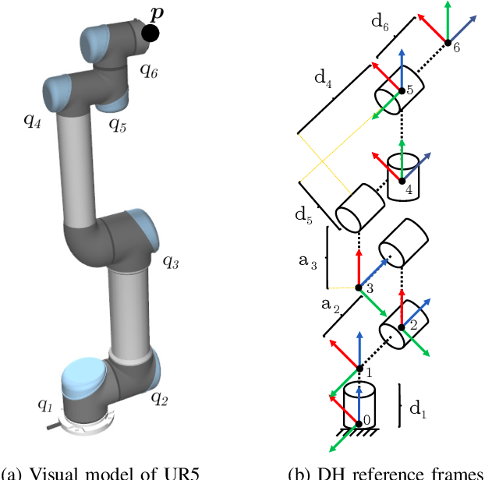
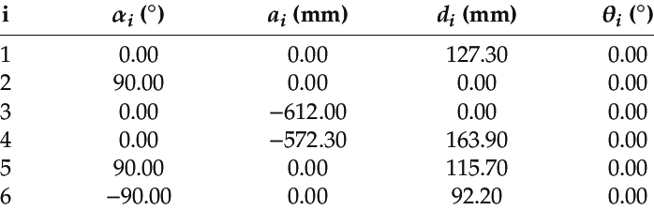
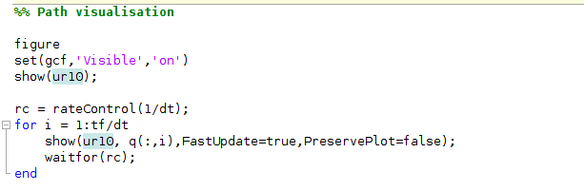
Artificial intelligence : robotics

Slide 11
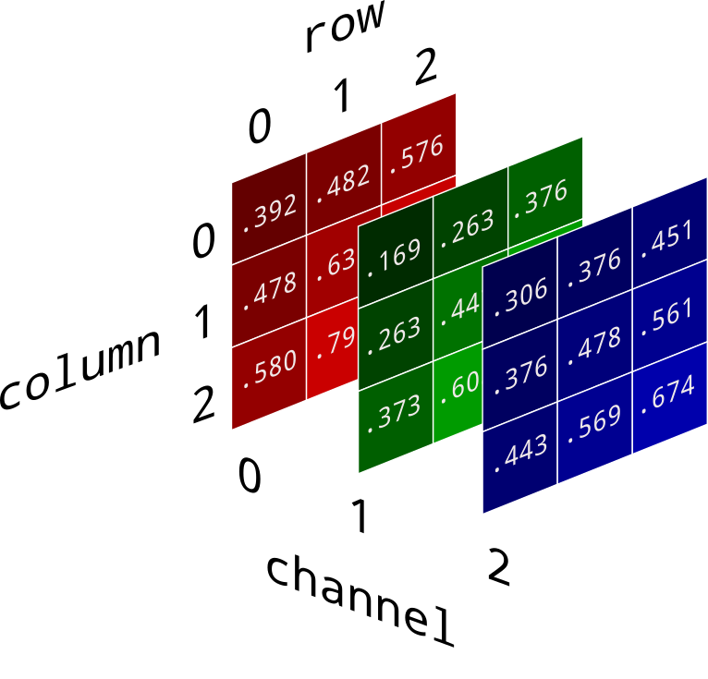
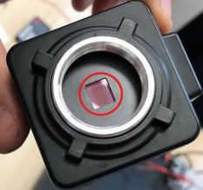
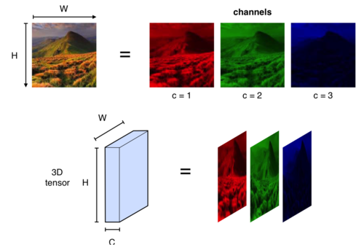

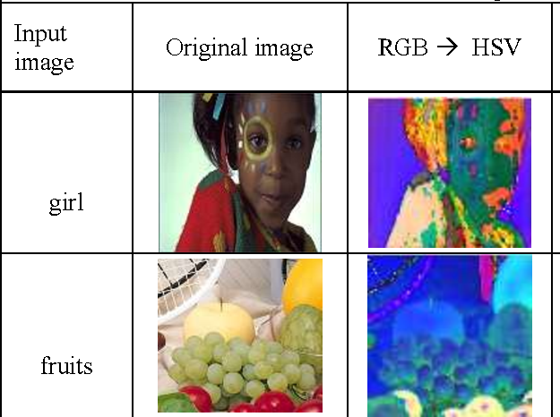
Artificial intelligence : computer vision
Computer vision focuses on building and using digital systems to process visual data with the aim to equipping a system capable of perceiving the environment and thus making decisions.
A camera convert the scene-lux to a electrical signal through CCD/CMOS sensors
An image data is a UNIT8 tensor with 3 channel

Slide 12
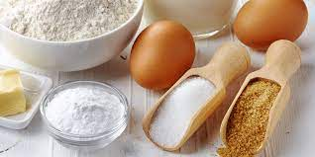
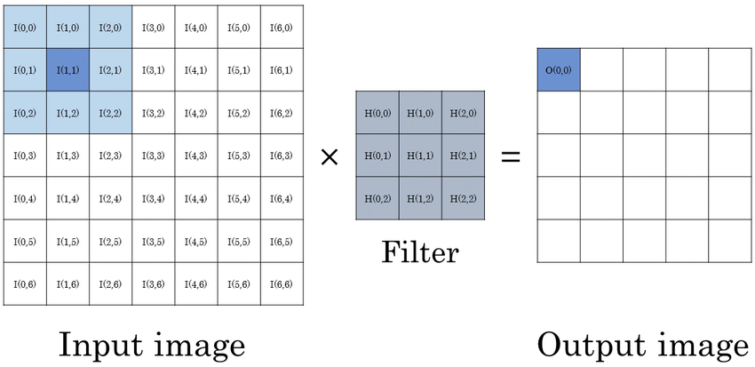
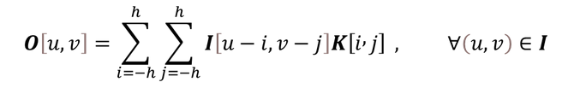

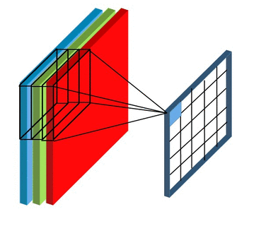
Artificial intelligence : computer vision
Convolution operation

Slide 13
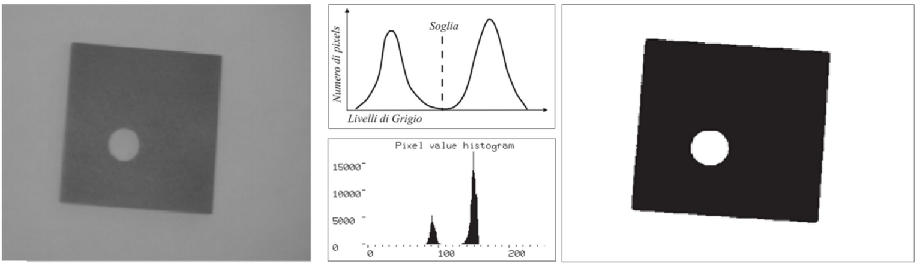
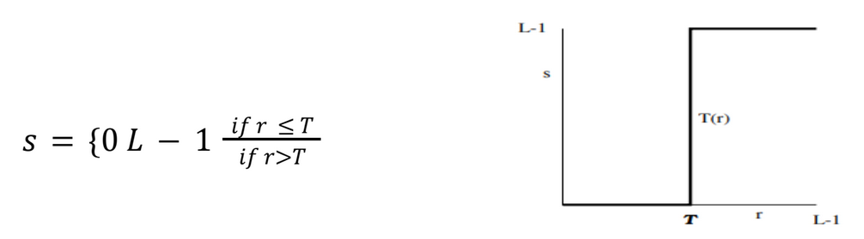
Artificial intelligence : computer vision
There are some cameras that does not have the capacity to capture color (monocromatic). The digital result is a matrix (2D tensor) that contain only information about gray level.
From any image we can get the greyscale one with different methods.
From a grayscale image we can get the binary one (b/w) observing the histogram of pixel's intensity.
Founded a threshold in this way we can apply a low pass filter on image

Slide 14
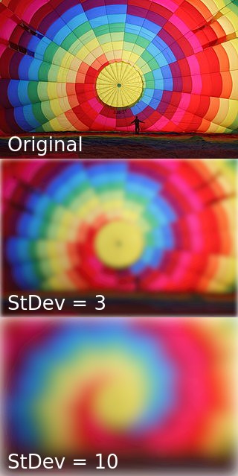
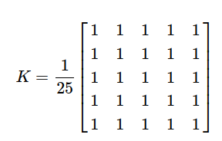
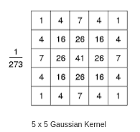
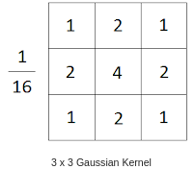
Artificial intelligence : computer vision
As in one-dimensional signals, images also can be filtered with various low-pass filters (LPF), high-pass filters (HPF), etc. LPF helps in removing noise, blurring images, etc. HPF filters help in finding edges in images. Keep this kernel above a pixel, add all the 25 pixels below this kernel, take the average, and replace the central pixel with the new average value.
The standard deviation of the Gaussian distribution in X and Y direction should be chosen carefully considering the size of the kernel such that the edges of the kernel is close to zero.You have to choose a right size of the kernel to define the neighborhood of each pixel. If it is too large, small features of the image may be disappeared and the image will look blurred. If it is too small, you cannot eliminate noises in the image.

Slide 15
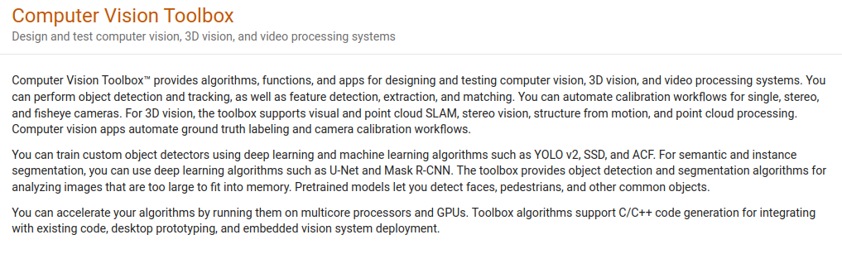
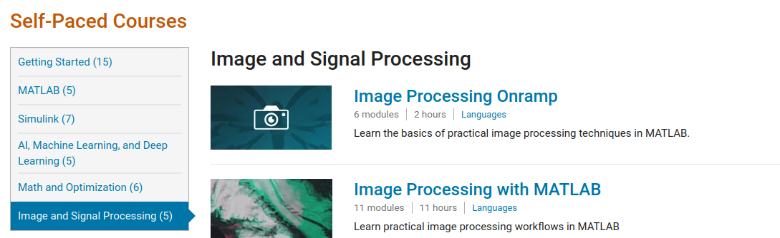
Artificial intelligence : computer vision
https://it.mathworks.com/help/vision/

Slide 16
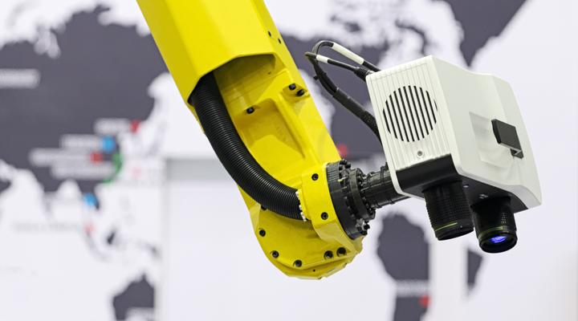
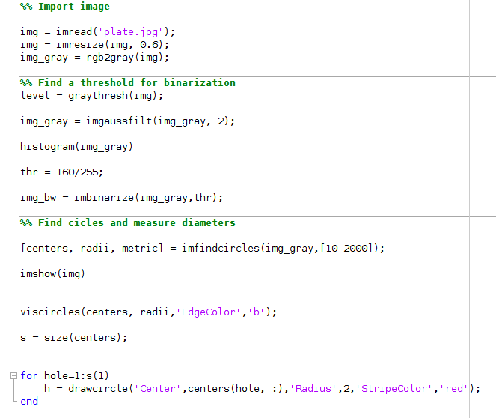
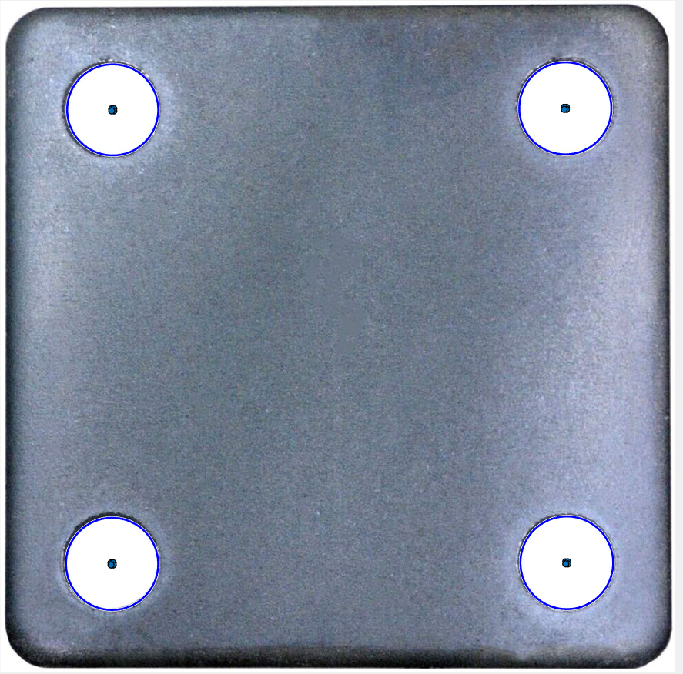
Artificial intelligence : computer vision

Slide 17
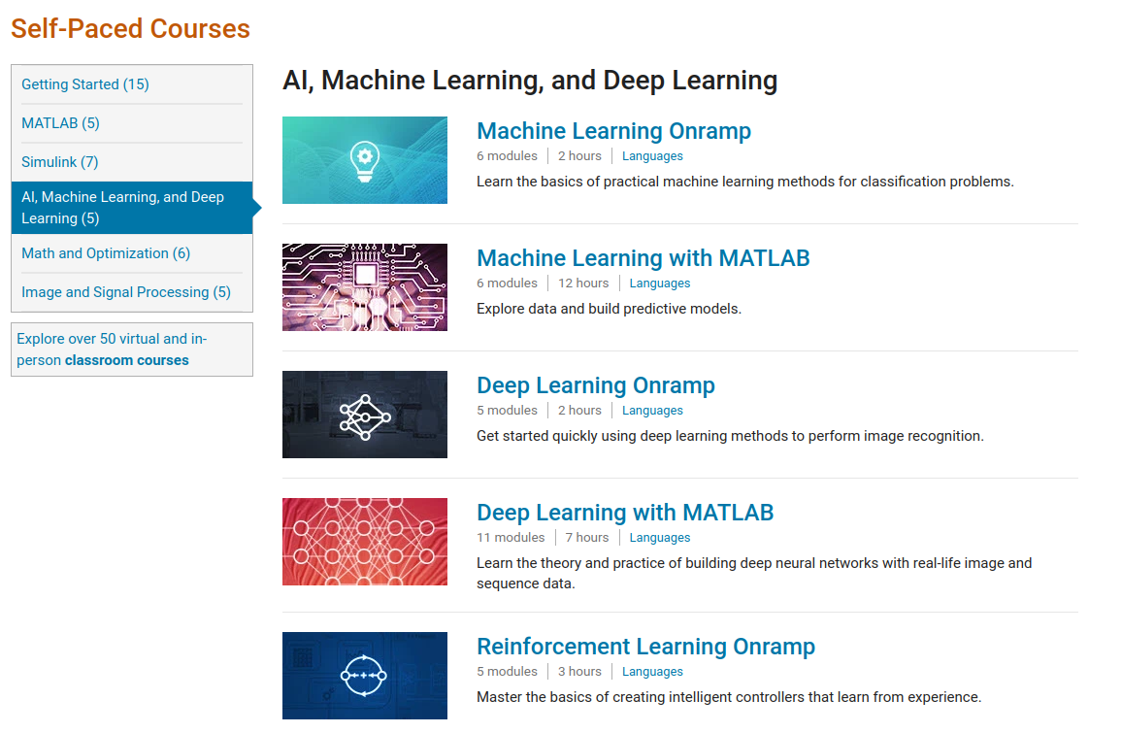
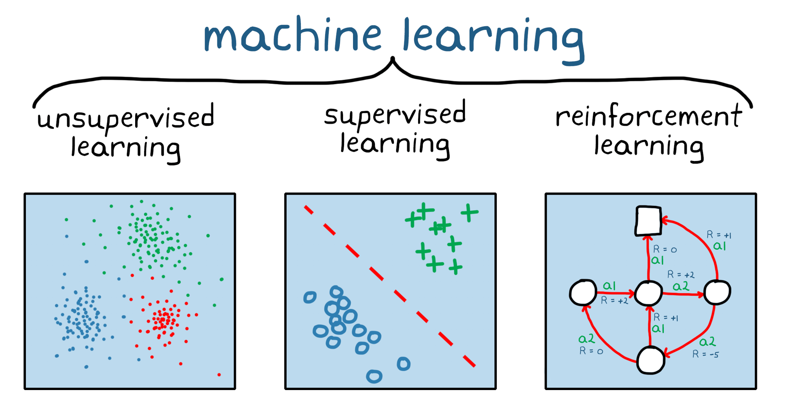
Artificial intelligence : deep learning
Machine learning refers to a set of techniques which allow computer systems to learn directly from data and adapt without following explicit instructions, using statistical methods and optimisation techniques.

Slide 18
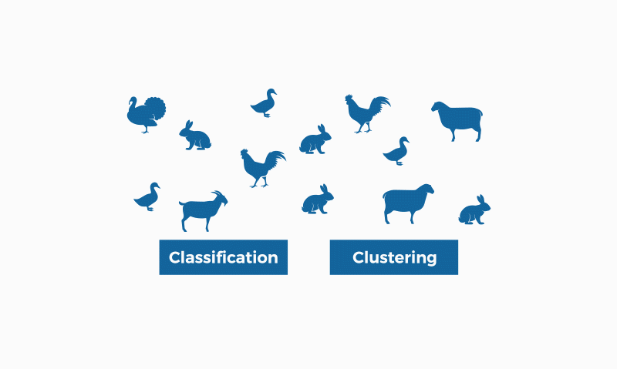
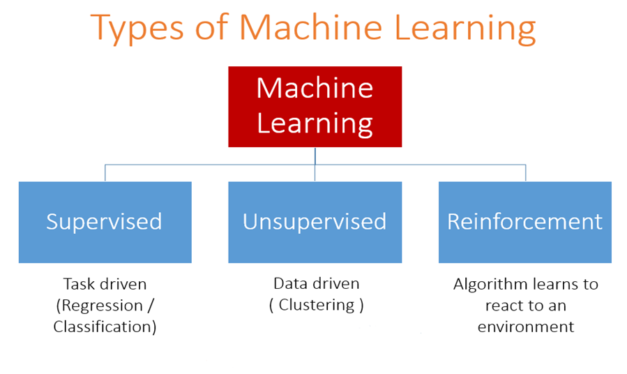
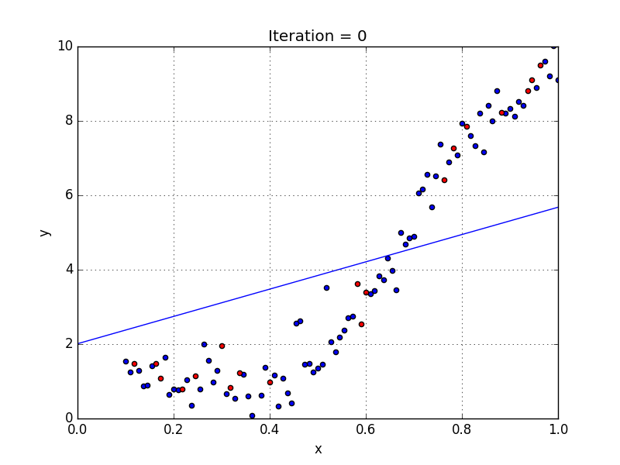
Artificial intelligence : deep learning
Machine learning refers to a set of techniques which allow computer systems to learn directly from data and adapt without following explicit instructions, using statistical methods and optimisation techniques.

Slide 19
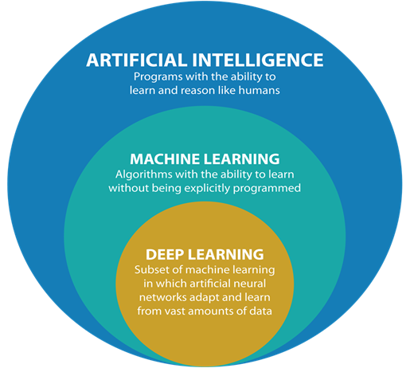
Artificial intelligence : deep learning
Machine learning refers to a set of techniques which allow computer systems to learn directly from data and adapt without following explicit instructions, using statistical methods and optimisation techniques.
Demo:
Tool wear estimation during drilling operation on composite materials (regression)
Defect detection during Gas Metal Arc Welding (classification)
Reduced Order Model of an Additive Manufacturing process

Slide 20
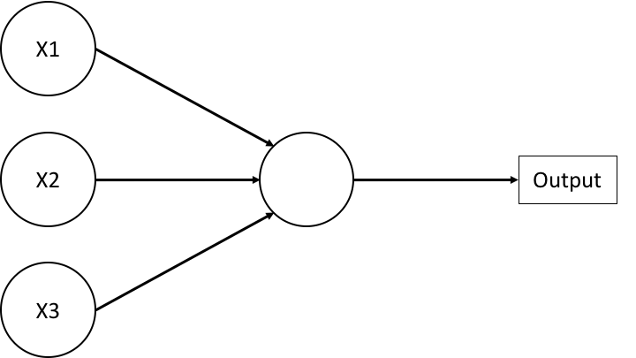
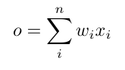

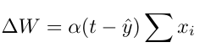
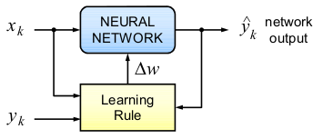
Artificial intelligence : deep learning
A neuron is a linear combination of the input.
Widrow and Hoff invented a method to update the weights (connections) in order to reduce the error between targets and prediction through an intuition. (delta rule)

Slide 21
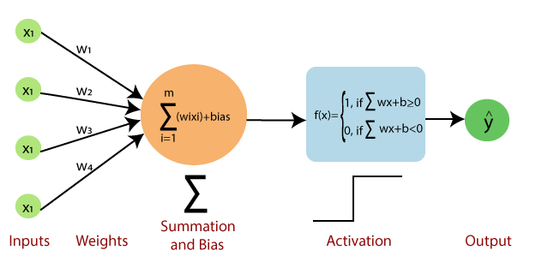
Artificial intelligence : deep learning
In the 1957 Rosenblatt introduced the concept of activation function.
With a non linear step function is possible solve a binary classification problem

Slide 22
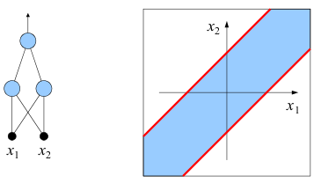
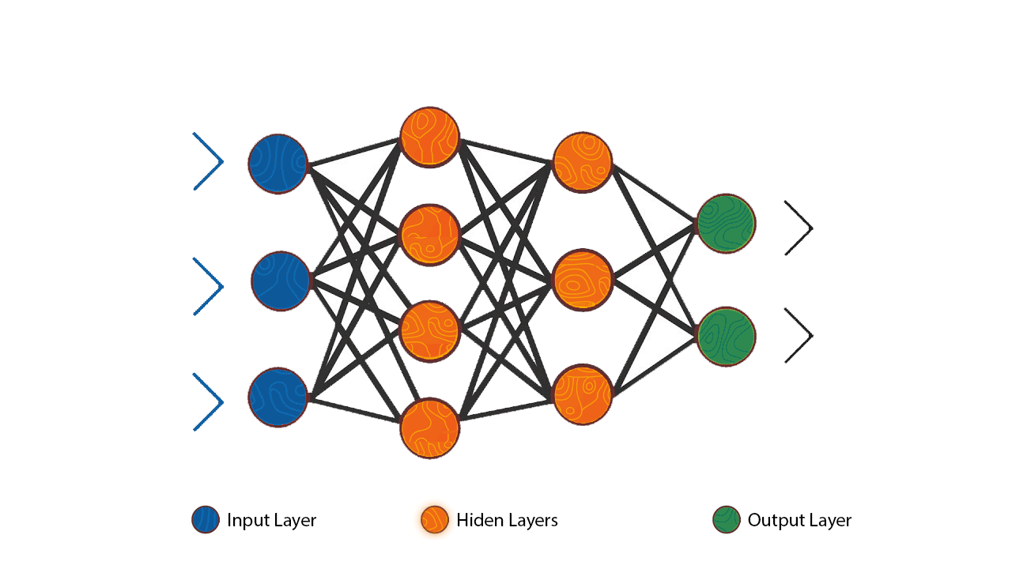
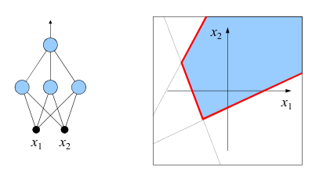
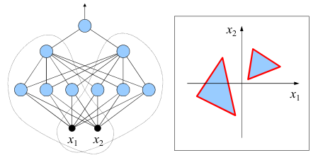
Artificial intelligence : deep learning
In the 1957 Rosenblatt introduced the concept of activation function.
With a non linear step function is possible solve a binary classification problem
In 1969, Minsky & Papert showed the strongest limit of the Perceptron: to learn a classification, the problem must be linearly separable
Research found that the problem could be solved:
using more hidden layers where all the neurons of a layer are connected to all the neurons of the next layer and there are no connections between neurons in the same layer and between non adjacent layers. (Rumelhart-Hinton-Williams, 1986)
Using differents activation function

Slide 23



Artificial intelligence : deep learning
In 1989, George Cybenko proved an important results known as the Universal Approximation Theorem.
A feed-forward network with a single hidden layer of neurons with a sigmoid activation function can approximate any continuous function.
The learning phase uses gradient descent-based optimization methods to update the network weights

Slide 24

Artificial intelligence : deep learning
There are several hyperparameters to tune in a neural network.
Learning rate
Weights initialisation method
Momentum gamma (in SGD)
Decay rate of learning rate
And really more…
https://matlabacademy.mathworks.com/#ai

Slide 25

Artificial intelligence : deep learning
DEMO 1 : Tool wear estimation during drilling operation of composite materials
Audio, vibration, torque and force signals are acquired
Mean, variance, kurtosis, skewness and energy features were extracted for each signal -> 20 features
Also the tool aging is considered using the hole number -> 21 features
Caggiano, Alessandra, and Luigi Nele. "Artificial neural networks for tool wear prediction based on sensor fusion monitoring of CFRP/CFRP stack drilling." International Journal of Automation Technology 12.3 (2018): 275-281.

Slide 26



Artificial intelligence : deep learning
DEMO 1 : Tool wear estimation during drilling operation of composite materials

Slide 27


Artificial intelligence : deep learning
DEMO 1 : Tool wear estimation during drilling operation of composite materials

Slide 28



Artificial intelligence : deep learning
DEMO 2 : Defect detection during GMA Welding
85% accuracy
Nele, Luigi, Giulio Mattera, and Mario Vozza. "Deep Neural Networks for Defects Detection in Gas Metal Arc Welding." Applied Sciences 12.7 (2022): 3615.

Slide 29

Artificial intelligence : deep learning

Slide 30


https://content.mathworks.com/viewer/63814a32c8ce21bfab25787d
Artificial intelligence : deep learning
DEMO 3 : ROM of AM process

Slide 31

Artificial intelligence : deep learning
DEMO 3 : ROM of AM process

Slide 32




Artificial intelligence : deep learning
WFS
DEMO 3 : ROM of AM process
CTWD
V
WS

Slide 33



Artificial intelligence : deep learning
WFS
DEMO 3 : ROM of AM process
CTWD
V
WS

Slide 34

Artificial intelligence : deep learning
WFS
DEMO 3 : ROM of AM process
CTWD
V
WS

Slide 35

Artificial intelligence : deep learning
WFS
DEMO 3 : ROM of AM process
CTWD
V
WS

Slide 36


Artificial intelligence : deep learning
DEMO 3 : ROM of AM process

Slide 37
Artificial intelligence : deep learning
DEMO 3 : ROM of AM process

Slide 38



Artificial intelligence : deep learning
DEMO 3 : ROM of AM process

